Slide 1

Full-Stack Web Development Workshop
Master Node.js, Express, APIs, and Databases in One Day

Slide 2
The Big Picture: How Web Apps Actually Work
Frontend
Backend
What users see and click on — the part you can touch and interact with.
The invisible engine processing every request behind the scenes.
Database
API
Where all the data actually lives — users, posts, orders, everything.
The bridge connecting all the pieces so they can talk to each other.

Slide 3

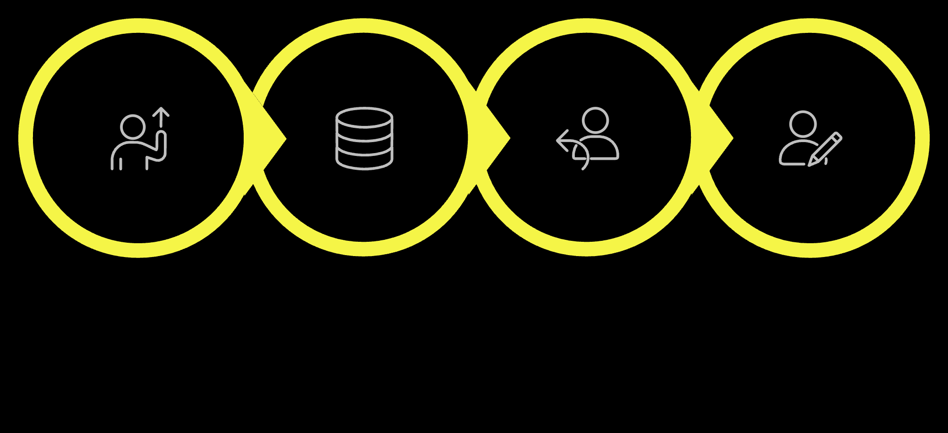
What Happens When You Click "Login"?
Send Request
Backend Check
Send Response
Update UI

Slide 4
Backend Basics: 4 Words to Remember
Client
Request
Your browser or app — the one asking for stuff.
"Hey server, get me this data" — a message sent from client to server.
Server
Response
The computer sitting there 24/7, listening for requests and doing the work.
"Here's your data" or "Error!" — the server's reply back to the client.

Slide 5

APIs: The Universal Language
API stands for Application Programming Interface — basically the contract that lets different apps talk to each other without knowing how each other works internally.
What APIs Do
JSON: The Data Format
Let completely different apps communicate — your app, Spotify, Google Maps, all talking to each other via APIs.
The standard format for sending data. Think: "structured text that computers understand" — like a really organized text message.

Slide 6
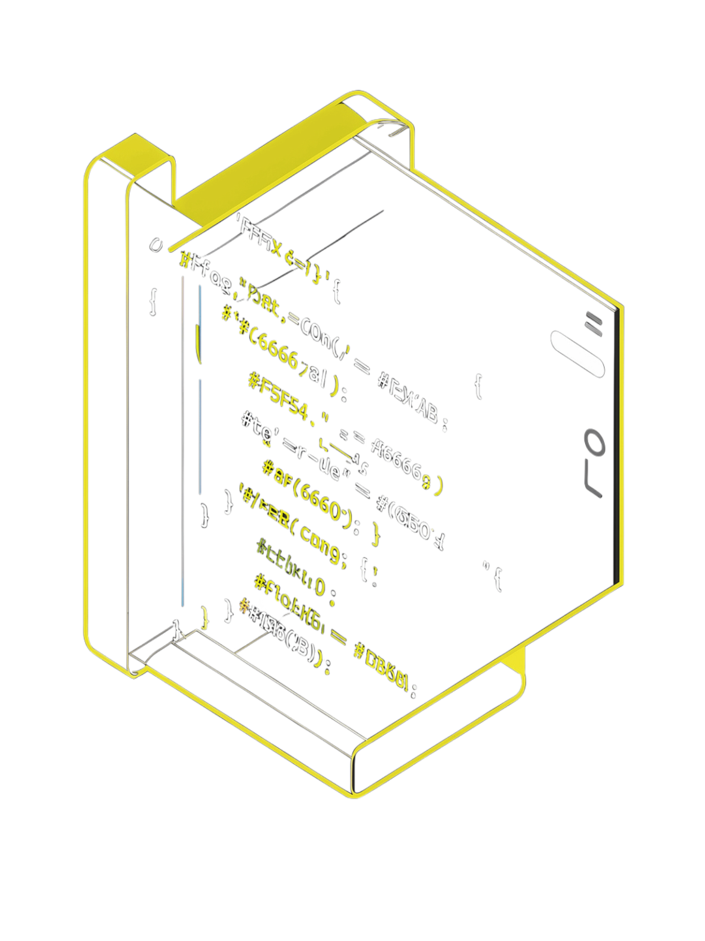
CHAPTER
Node.js: JavaScript Escapes the Browser
How JavaScript went from browser toy to full-blown server powerhouse.

Slide 7
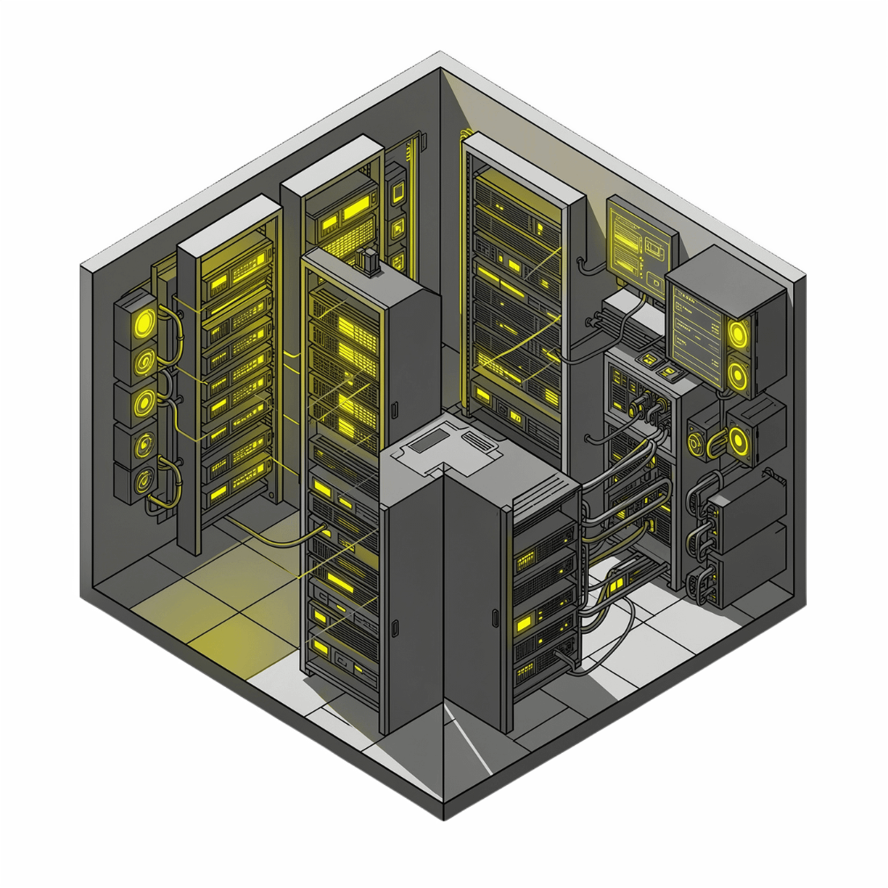

Node.js Explained
JavaScript, but everywhere
Before Node.js: JavaScript was stuck in the browser — great for buttons and animations, useless for servers.
Now: Node.js lets JavaScript run on servers, meaning you use the same language front-to-back. One language to rule them all. 🚀
The secret sauce is the V8 Engine — the same engine Chrome uses — now running your JavaScript on the server. Just fire it up with: node app.js

Slide 8
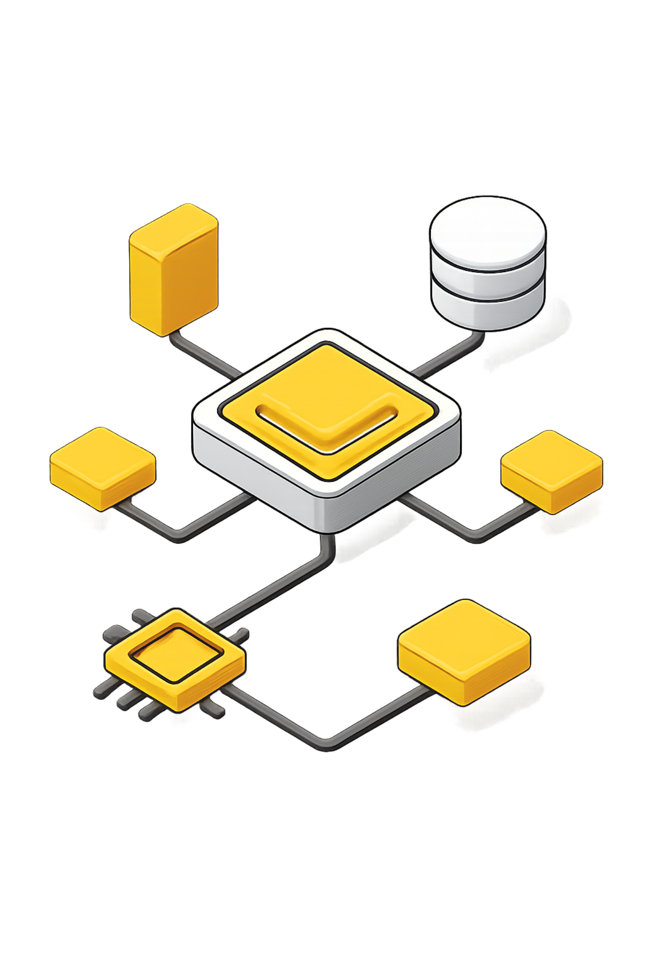
CHAPTER
Express.js: Making APIs Easy
From raw requests to structured responses, learn how Express.js streamlines backend development.

Slide 9
Thank You!
We've covered the foundational technologies for building powerful full-stack web applications. Here's a quick recap of the core concepts:
Node.js
Express.js
Server-side JavaScript runtime
Minimalist web framework for Node.js
REST APIs
CRUD Operations
Standard for web service communication
Create, Read, Update, Delete data
SQL Databases
MongoDB
Structured relational data storage
Flexible NoSQL document database
Questions? Let's code! 🚀

Slide 10
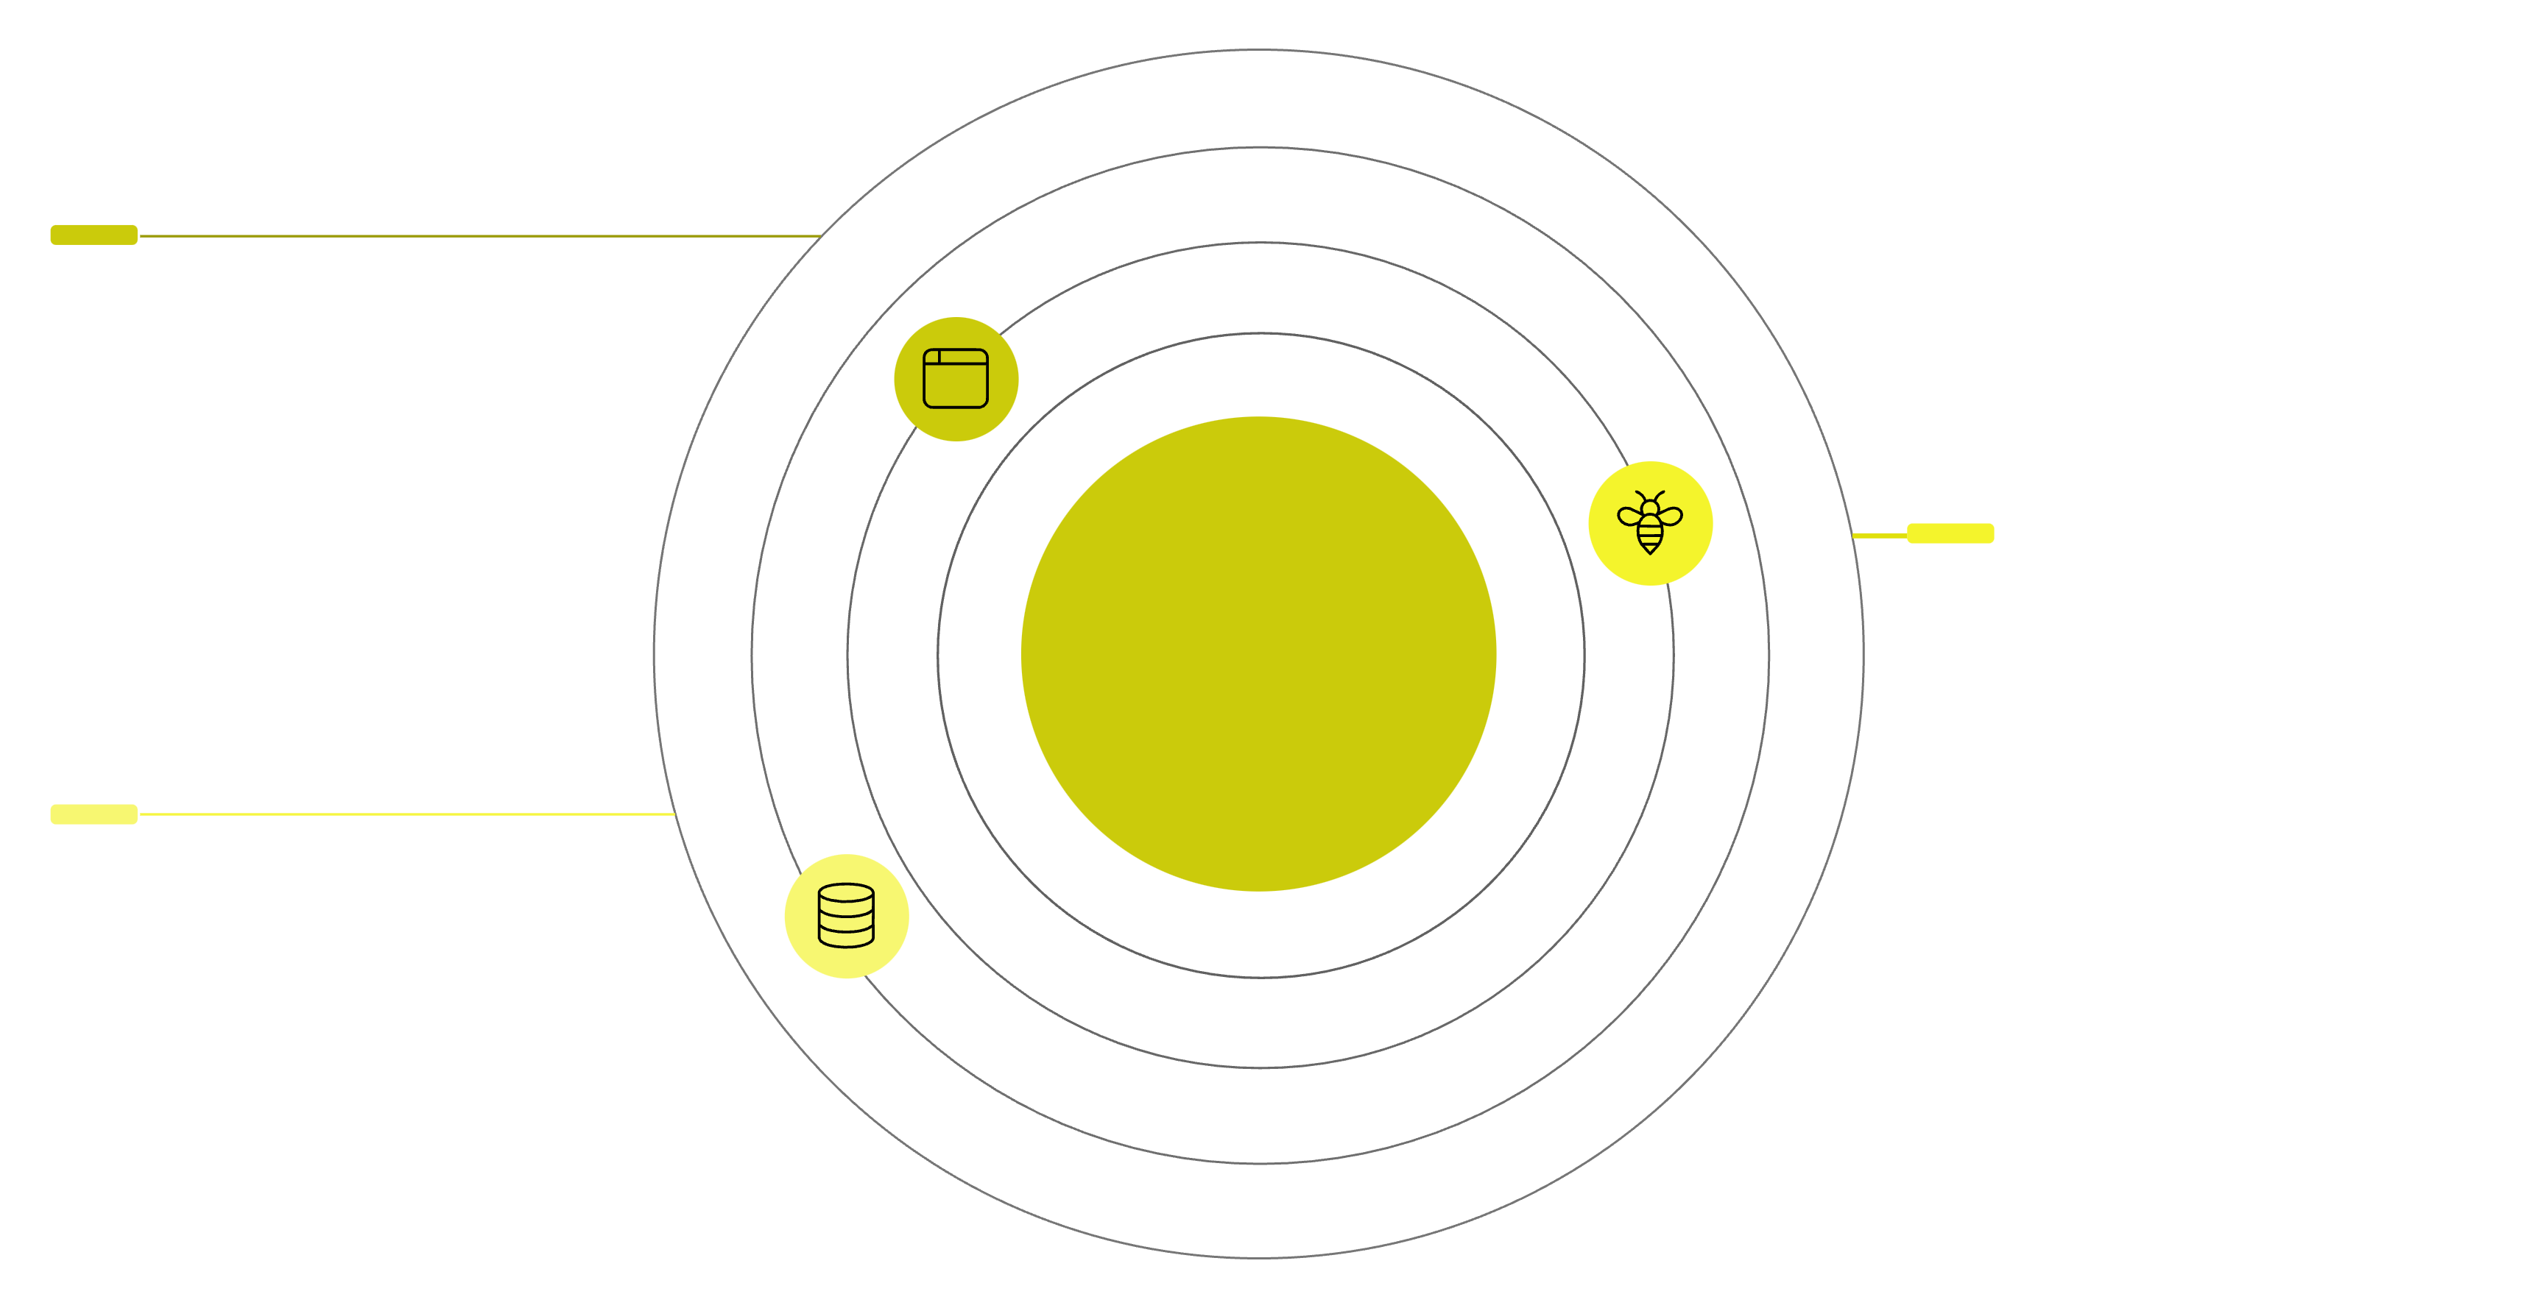
You've Got This!
Frontend
User interface in browser or app
Frontend → API → Database
API
Handles requests and business logic
Database
Stores and retrieves application data
You now understand the core components that make modern web applications tick. From the user's browser (Frontend) to the intermediary translator (API) and the data storage hub (Database) – you have the roadmap.
The best way to solidify this knowledge is to build! Start with simple projects, experiment with Node.js and Express, connect to a database, and watch your ideas come to life. Keep learning, keep coding, and keep building!

Slide 11

CHAPTER
Putting It All Together
Now let's connect the dots: build a full-stack application from scratch using Node.js, Express, and a database.

Slide 12
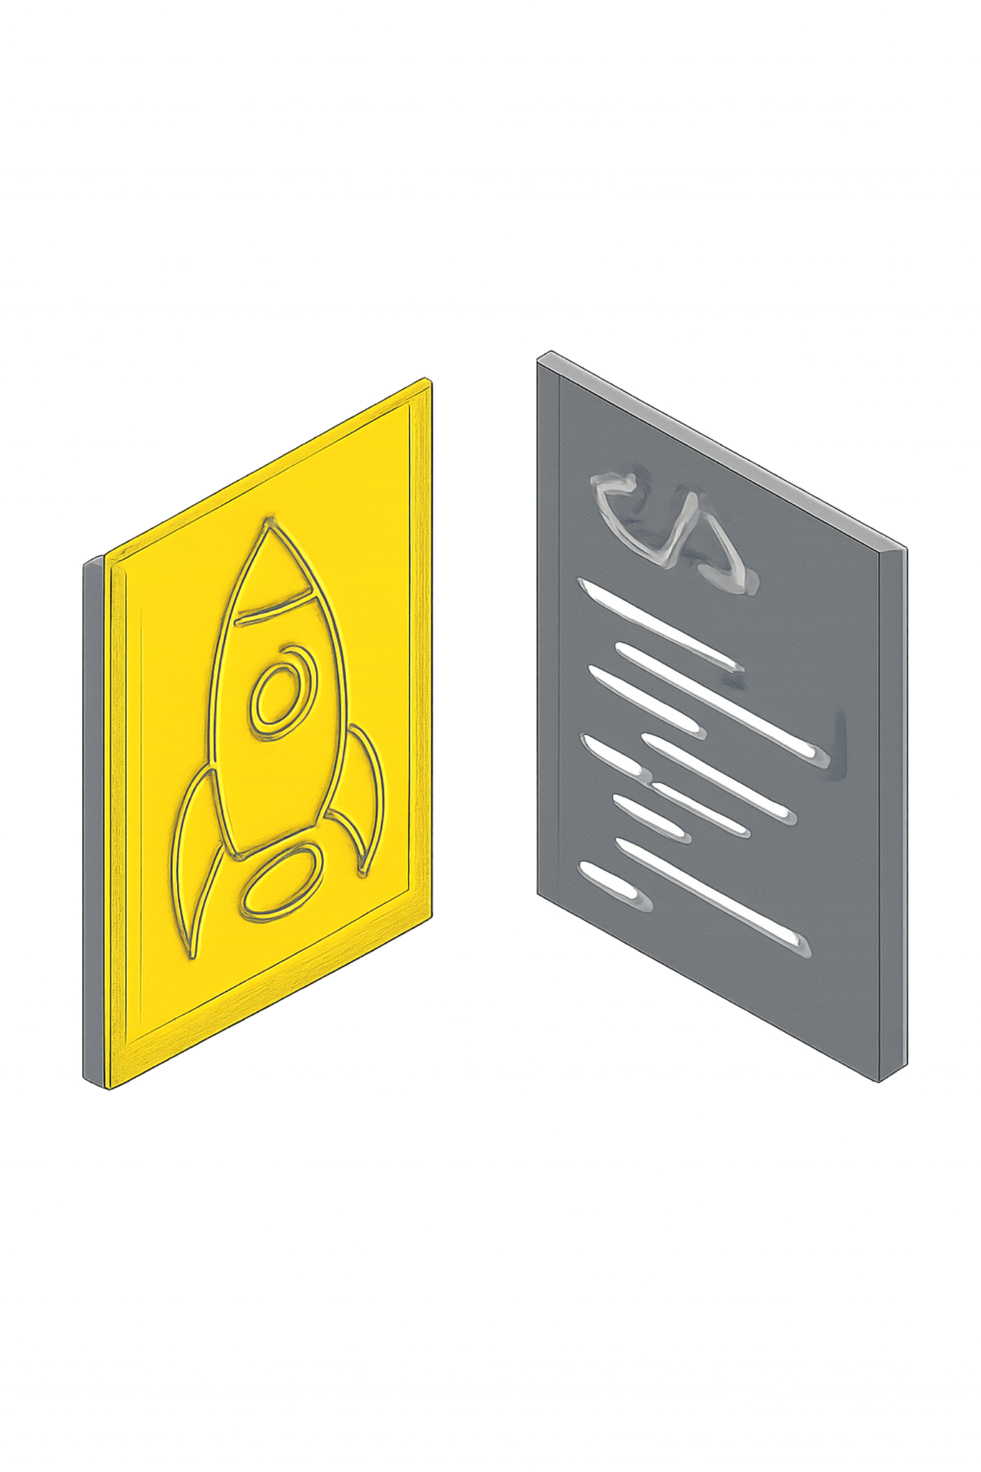
CHAPTER
SQL vs MongoDB: Choosing Your Database
Understanding the core differences helps you pick the right tool for the job.
SQL Databases (Relational)
MongoDB (NoSQL Document)
Think of data stored in rigid, predefined tables with rows and columns, like a highly organized spreadsheet.
Stores data in flexible, JSON-like documents. Each document can have its own unique structure, like a folder of varied papers.
Structured Schema: Requires a strict blueprint (schema) for data before anything can be stored. Changes are often complex.
Relational Model: Data is linked across multiple tables using foreign keys, ensuring strong relationships and data integrity.
Strong Integrity: Guarantees data accuracy and reliability through ACID (Atomicity, Consistency, Isolation, Durability) properties.
Use Cases: Financial transactions, traditional business applications, any data with complex, interconnected relationships (e.g., e-commerce orders, inventory).
Flexible Schema: No predefined schema; documents can change their structure (add fields) on the fly without downtime.
Document Model: Data is often stored within a single document, reducing the need for joins and simplifying access.
Scalability: Designed for horizontal scaling (sharding) across many servers, making it excellent for large volumes of data.
Use Cases: Content management, real-time analytics, mobile apps, user profiles, or data that changes rapidly and has varying structures.

Slide 13
How SQL Connects to Your API
Frontend sends a request
Express receives the request
Browser → GET /students
app.get('/students', (req, res) => { ... })
API queries the database
SQL returns the data
SELECT * FROM students;
Database sends back all student records
API sends response back
Frontend displays the data
res.json(students);
Browser shows the list of students
The Connection:
Frontend (what user sees) ↔ API (Express) ↔ Database (SQL)
Your API is the translator between what users want and what the database can do. SQL is the language the database understands.

Slide 14
SQL: Structured Data in Tables
SQL organizes data in tables with rows and columns, like a spreadsheet. Each row is a record, each column is a field.
The 4 SQL CRUD Commands:
INSERT
SELECT
Create new data
Adds a new row to a table
Read data
Retrieves rows from a table
INSERT INTO students (name, dept) VALUES ('Alice', 'CS');
SELECT * FROM students WHERE dept = 'CS';
UPDATE
DELETE
Modify existing data
Changes values in existing rows (⚠️ always use WHERE!)
Remove data
Deletes rows from a table (⚠️ always use WHERE!)
UPDATE students SET dept = 'Math' WHERE name = 'Alice';
DELETE FROM students WHERE name = 'Alice';
Why SQL?
Structured and organized
Perfect for related data (orders, customers, products)
Strong data integrity and consistency
Great for complex queries

Slide 15
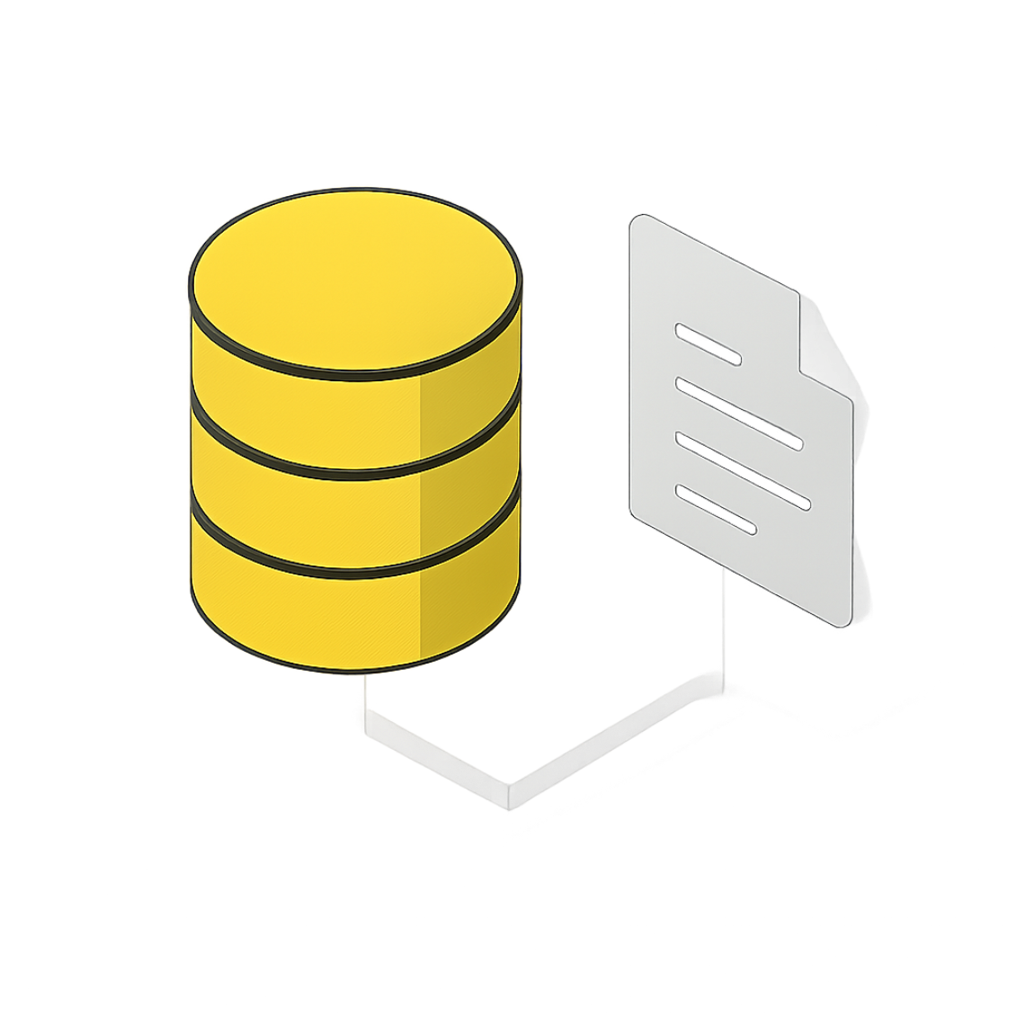
MongoDB: Flexible JSON Documents
MongoDB is a NoSQL database that stores data in flexible, JSON-like documents, allowing for a more agile and dynamic approach to data storage.
Documents
1
The primary unit of data in MongoDB, similar to rows in a relational database, but much richer and self-contained.
No Strict Schema
2
Documents within the same collection don't need to have identical structures. Add fields on the fly as your application evolves.
Collections
3
Groups of documents, analogous to tables. Unlike tables, a collection can hold documents with diverse structures.
Rapid Development
4
The schema-less nature accelerates development cycles, making it ideal for fast-paced projects and evolving data requirements.

Slide 16
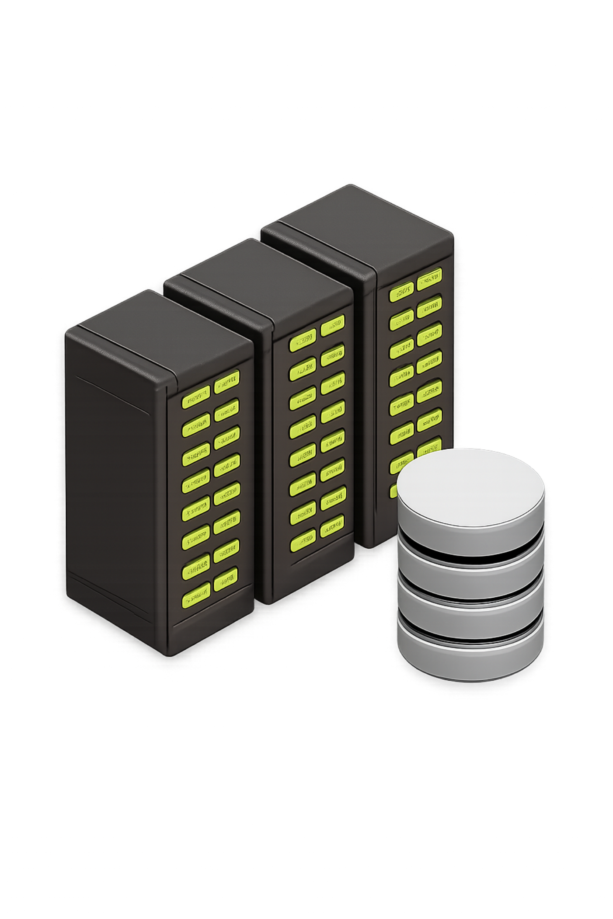
CHAPTER
Databases: Where Data Lives
Understanding how to store, retrieve, and manage your application's most valuable asset.

Slide 17
Thank You! 🚀
We've covered the foundational technologies for building powerful full-stack web applications. Here's a quick recap of the core concepts:
How web apps work
Node.js
Frontend → API → Database
runs JavaScript on servers
Express
SQL
makes building APIs simple
stores structured data in tables
MongoDB
Student API
stores flexible JSON documents
How to build a real one
Next Steps:
01
02
03
Install Node.js and Express
Create your first API endpoint
Connect to a database (SQL or MongoDB)
04
05
Build the Student Management API
Deploy and share with the world!
Remember: The best way to learn is by building. Start small, experiment, break things, fix them, and keep learning.
Questions? Let's code! 💻

